Slide 1
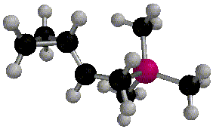
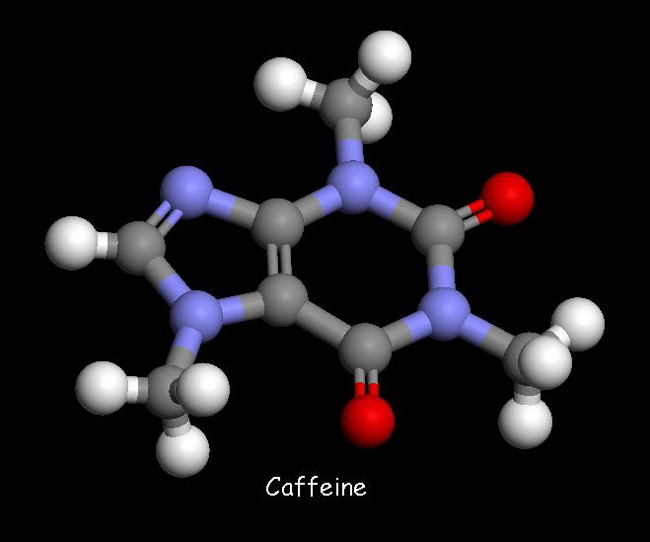
Organic Chemistry
Nomenclature: Alkanes

Slide 2
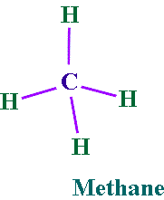
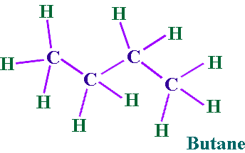
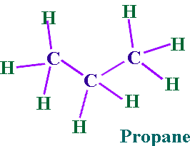
Alkanes
Hydrocarbon chains where all the bonds between carbons are SINGLE bonds
Name uses the ending –ane
Examples: Methane, Propane, Butane, Octane, 2-methylpentane

Slide 3
Summary: IUPAC Rules for Alkane Nomenclature
1. Find and name the longest continuous carbon chain. This is called the parent chain. (Examples: methane, propane, etc.)
2. Number the chain consecutively, starting at the end nearest an attached group (substituent).
3. Identify and name groups attached to this chain. (Examples: methyl-, bromo-, etc.)
4. Designate the location of each substituent group with the number of the carbon parent chain on which the group is attached. Place a dash between numbers and letters. (Example: 3-chloropentane)
5. Assemble the name, listing groups in alphabetical order. The prefixes di, tri, tetra etc., used to designate several groups of the same kind, are not considered when alphabetizing. Place a comma between multiple numbers. (Example: 2,3-dichloropropane)

Slide 4


Step 1. Find the parent chain.
Where is the longest continuous chain of carbons?

Slide 5
Prefixes for # of Carbons
1 | Meth | 6 | Hex
2 | Eth | 7 | Hept
3 | Prop | 8 | Oct
4 | But | 9 | Non
5 | Pent | 10 | Dec

Slide 6
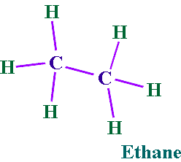
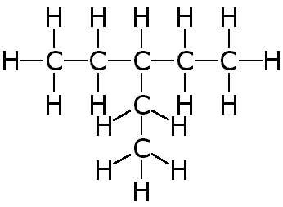
Endings
Alkanes (all C-C single bonded parent chain) end in –ane
Methane CH₄
Ethane C₂H₆
Propane C₃H₈
Attached carbon groups (substituents) end in –yl
Methyl CH₃ -
Ethyl CH₃CH₂-
Propyl CH₃CH₂CH₂ –
3-ethylpentane

Slide 7
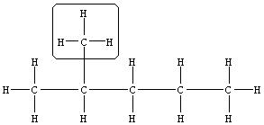
Step 2. Number the parent chain.
Number the parent chain so that the attached groups are on the lowest numbers
Methyl is on carbon #2 of the parent chain
Methyl is on carbon #4 of the parent chain
1 2 3 4 5
GREEN is the right way for this one!
5 4 3 2 1
2
3 7 8
4 5 6
8 7
6 2 1
5 4 3
2 3 4 5 6
7
6 5 4 3 2
1
Groups on 4, 6, and 7
Groups on 2 and 5
Groups on 2, 3, and 5
Groups on 3 and 6

Slide 8
Step 3. Name the attached groups.
Carbon (alkyl) groups
Methyl CH₃ -
Ethyl CH₃CH₂-
Propyl CH₃CH₂CH₂ –
Halogens
Fluoro (F-)
Chloro (Cl-)
Bromo (Br-)
Iodo (I-)

Slide 9
Step 4. Designate where the group is attached to the parent chain.
Use the numbers of the parent chain from step 2 to designate the location of the attached groups to the parent chain.
2-methyl
1 2 3 4 5

Slide 10
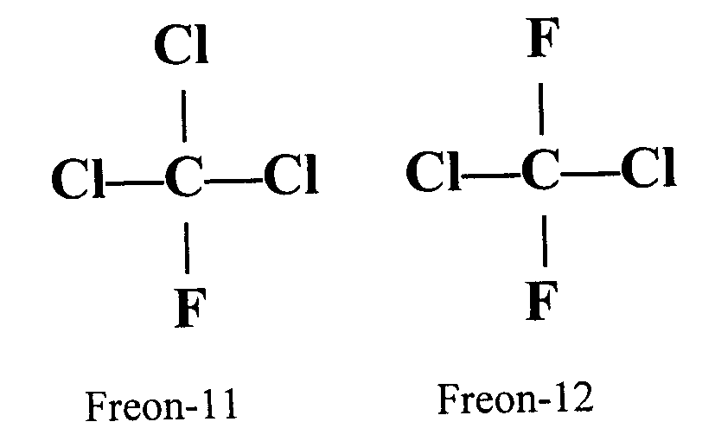
Step 5. Alphabetize the groups, combine like groups, and assemble.
The prefixes di, tri, tetra etc., used to designate several groups of the same kind
Prefixes are not considered when alphabetizing (Example: dimethyl = m for alphabetizing)
Parent chain goes LAST
1,1,1-trichloro-1-fluoromethane
1,1-dichloro-1,1-difluoromethane

Slide 11

Draw Some Simple Alkanes
2-methylpentane
3-ethylhexane
2,2-dimethylbutane
2,3-dimethylbutane

Slide 12

Structural Formulas
“Lazy” way to write the Hydrogens
Instead of drawing the bonds, just state how many hydrogens are attached
NOTE: The bonds are between CARBONS in a parent chain, and not hydrogens!
Structural Formula
Lewis Structure

Slide 13

Order of Priority
IN A TIE, halogens get the lower number before alkyl groups
4-chloro-2-methylpentane or 2-chloro-4-methylpentane?

Slide 14

Order of Priority
IN A TIE between SIMILAR GROUPS, the group lower ALPHABETICALLY gets the lower number
4-bromo-2-chloropentane or 2-bromo-4-chloropentane ?

Slide 15
Isomers
Straight chain alkanes: An alkane that has all its carbons connected in a row.
Branched chain alkanes: An alkane that has a branching connection of carbons.
Isomers: Compounds with same molecular formula but different structures.

Slide 16
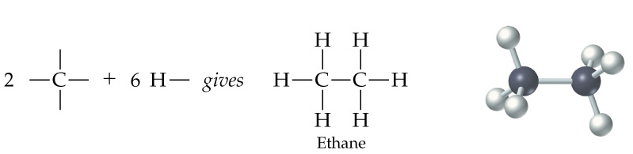
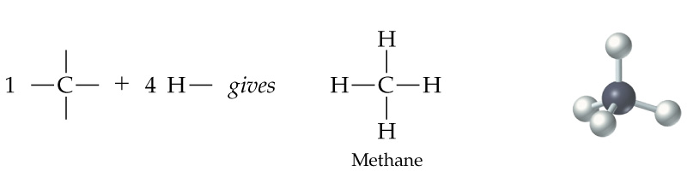
There is only one possible way that the carbons in methane (CH₄), ethane (C₂H₆), and propane (C₃H₈) can be arranged.

Slide 17
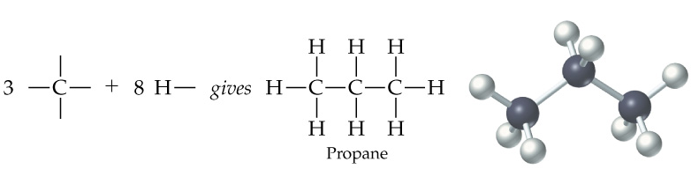

Slide 18
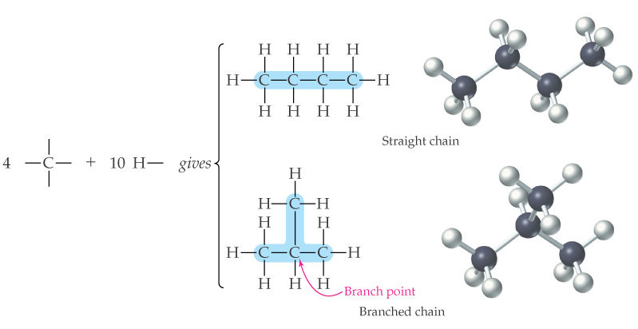
However, carbons in butane (C₄H₁₀) can be arranged in two ways; four carbons in a row (linear alkane) or a branching (branched alkane). These two structures are two isomers for butane.

Slide 19
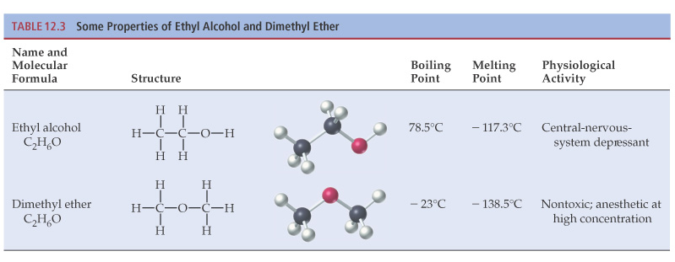
Different isomers are completely different compounds. They have different structures, different physical properties such as melting point and boiling point, and may have different physiological properties.

Slide 20
Learning Check
Draw all possible structural isomers of C₅H₁₂

Slide 21
Types of Carbon Atoms
Primary carbon (1º)
a carbon bonded to
one other carbon
Secondary carbon (2º)
a carbon bonded to
two other carbons
Tertiary carbon (3º)
a carbon bonded to
three other carbons

Slide 22
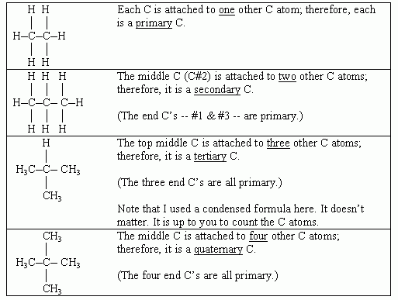

Slide 23
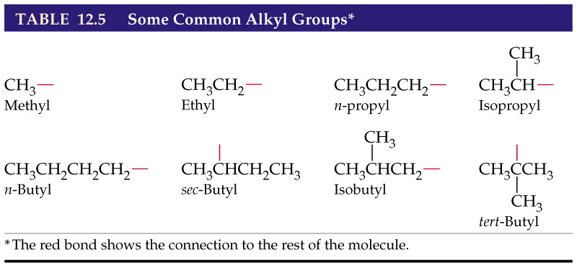

Slide 24
Alkanes
Example: Name the following compounds:

Slide 25
Alkanes
Example: Write the condensed structure for the following compounds:
3,3-dimethylpentane
4-sec-butyl-2-methyloctane
1,2-dichloro-3-methylheptane

